Slide 1
Overview of Breadboard #2 for BTNRH
December 2, 2016
WEA

Slide 2
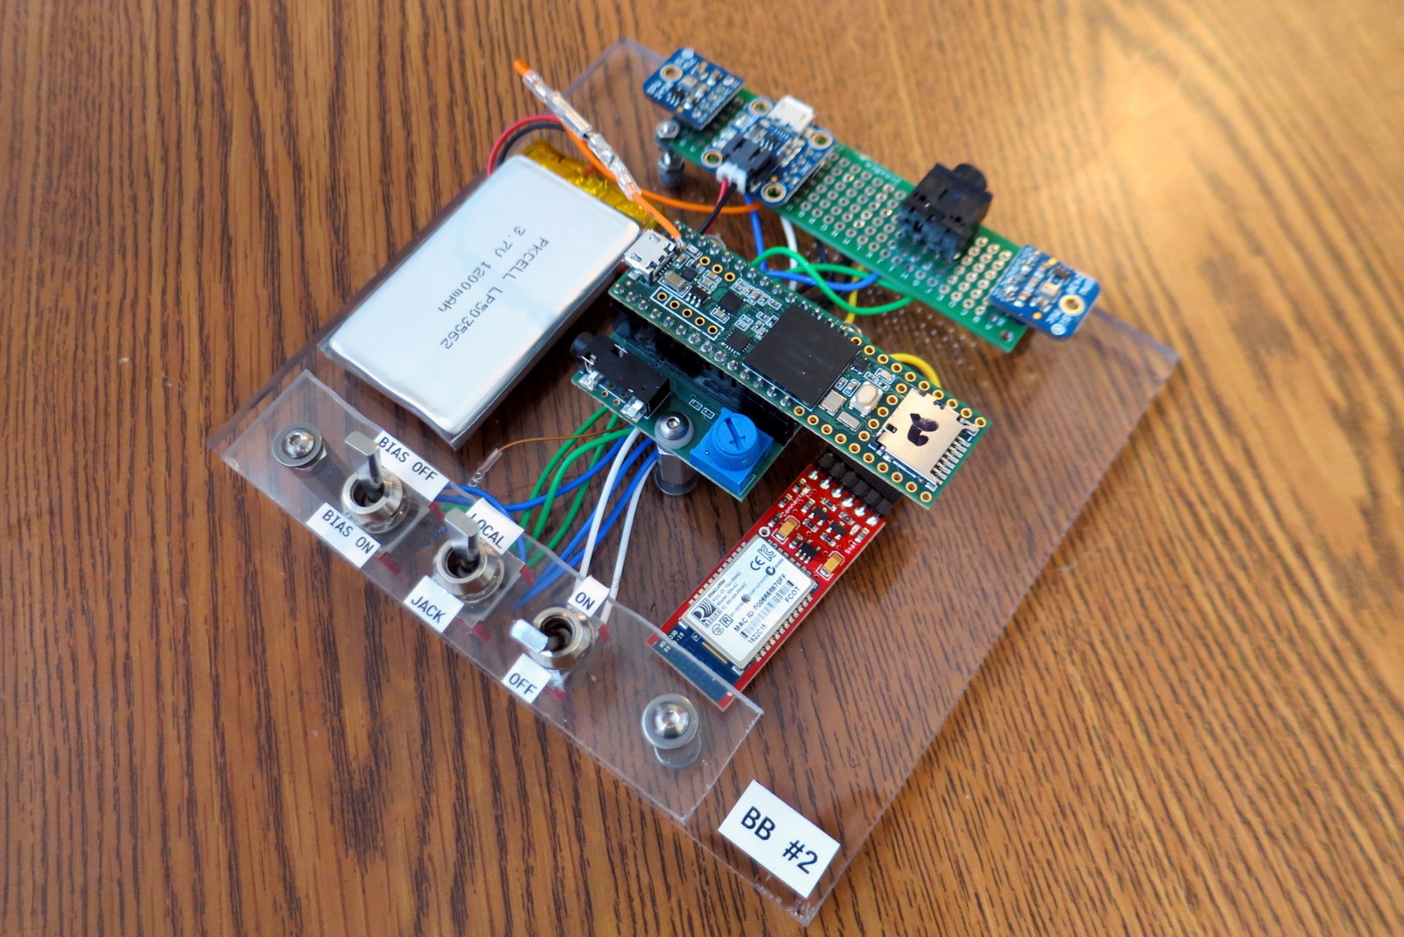
Overview of Breadboard #2
Built-In Mics
Recharge (USB)
Teensy 3.6
Power Switch

Slide 3
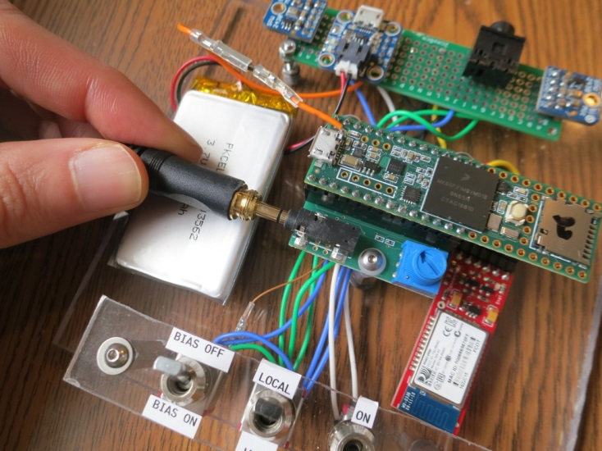
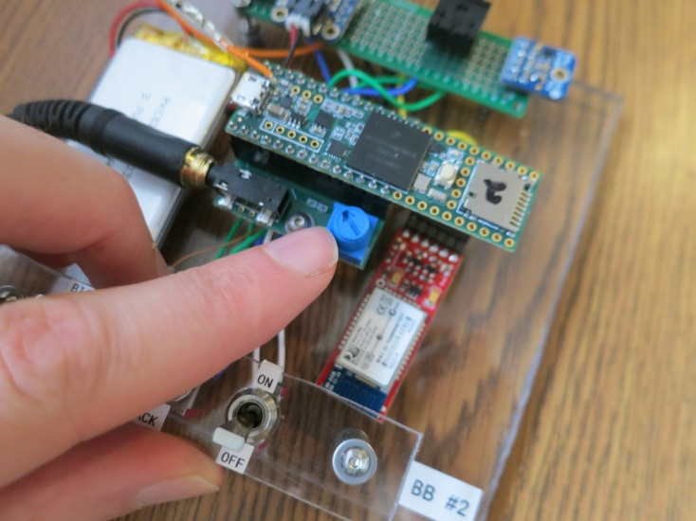
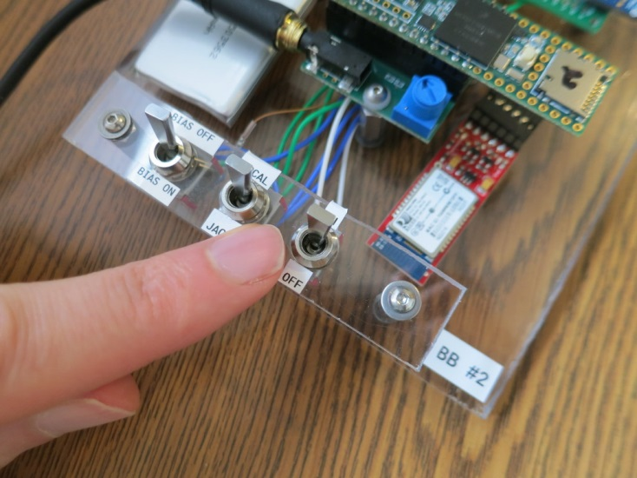
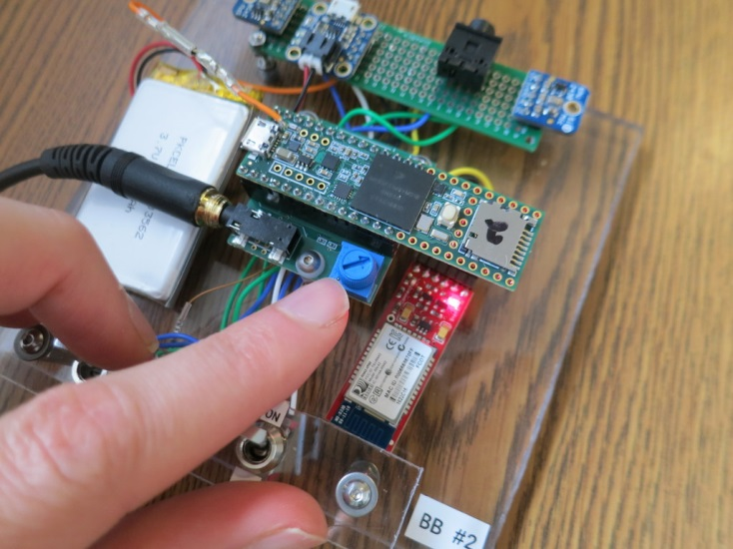
Getting Started (If the battery isn’t dead)
(1) Plug In Headphones
(2) Turn Down Volume
(3) Turn On System
(4) Turn Up Volume
(5) Listen!

Slide 4
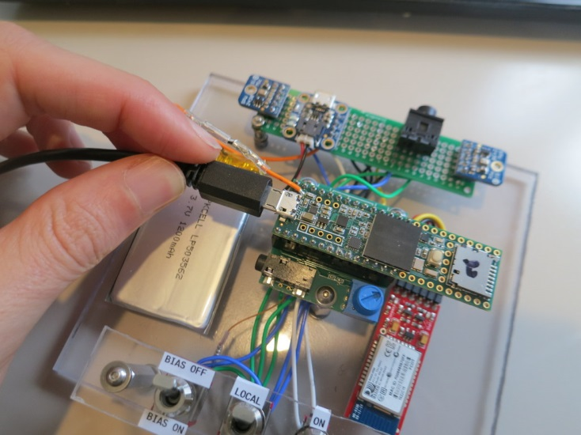
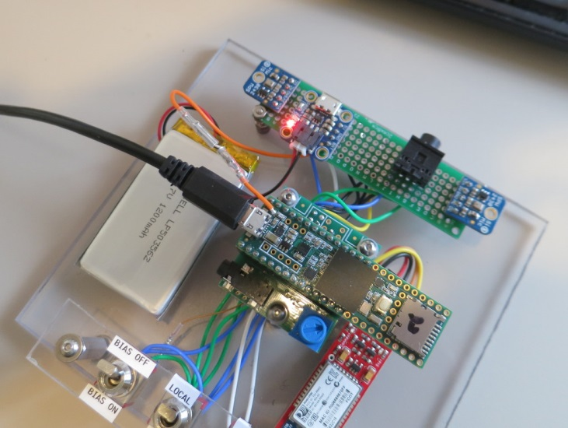
Powering / Recharging
(1) Plug In USB
(2) Red Means It’s Charging
Green Means It’s Charged.

Slide 5
Hardware Elements
Processor Board: Teensy 3.6
Buy. Pinout. Schematic.
Audio Interface: Teensy Audio Board
Buy. Pinout and Schematic.
Built-In Microphones: Knowles SPW2430
Buy Breakout. Knowles Product Page.
Bluetooth: RN-42
Buy Breakout. User Intro.
Battery: Lithium Ion Polymer
Buy. (choose any size >= 350 mA-hr)

Slide 6
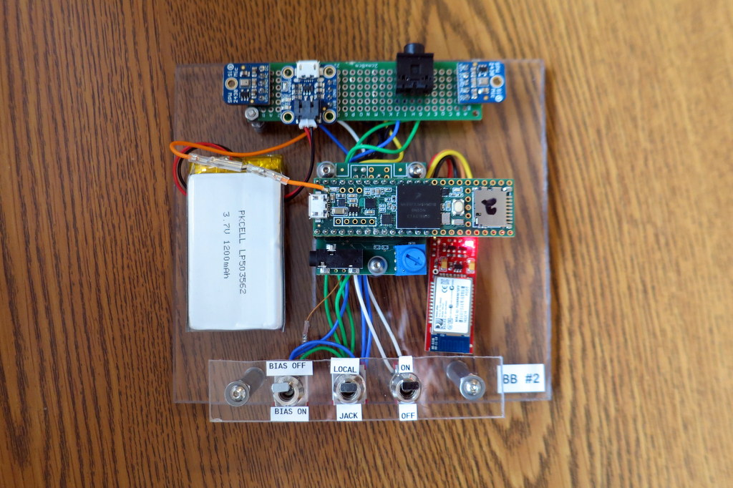
Elements of BB#2: Audio Sources
Microphone
Aux Input
Microphone
Switchable Bias
For Aux Input
Switch Mics
to Aux Input
System is pre-wired with two small microphones (“Local”)
Or, you can switch to Aux Input instead (“Jack”)
Aux Input is stereo. Use as line-in.
Or, it has switchable bias (~2V) to enable electret mics!

Slide 7
Elements of BB#2: Audio Output
Headphone
Jack
Programmable Knob
(Usually Gain)
Headphone jack is the only output
Using it as a line-out may cause ground issues. I only use it as a line-out with a battery-powered audio recorder
The blue knob is usually gain (or volume)
Can be re-programmed to be whatever function you’d like

Slide 8
Elements of BB#2: Power
Battery Status LEDs
Red=Charging, Green=Done
Power Input
(USB)
Battery
Power Switch
Powered from Battery or from USB
Battery recharges while USB is plugged in.
Red light while charging. Green light when charged.

Slide 9
Elements of BB#2: Bluetooth
Bluetooth
Has a Bluetooth Classic (not BLE) module
Is connected to Teensy’s “Serial1” port
Not really used right now. Will be used in future updates.
Connects to PCs and to Android devices (not iOS)
Default Pairing Code is “1234”
Default speed is 115200 bps (8-N-1)

Slide 10
All the Pieces
Battery
Microphone
USB for Power
and Programming
Aux Input
Microphone
Headphone
Jack
Teensy 3.6
Teensy Audio Board
Bias for
Aux Input
User Knob (Gain)
Built-In Mics
Vs Aux Input
Bluetooth
System
Power

Slide 11
Reprogramming
This device is built around the Teensy 3.6, which is aimed at hobbyists
It is programmed like an Arduino.
If you’ve never worked with an Arduino, you should start with an Arduino. See my guide here.
Once you get the Arduino stuff running, install the Teensy extensions
See my guide here [not yet ready…see here instead]
Finally, you can download my hearing aid examples
See my guide here [not yet ready]
My blog shows me working with the hardware here.
My library for Arduino/Teensy in my GitHub repo here
More programs are at my other other GitHub repo here.

